Slide 1
App Store Database Management INFO 6210 GROUP 25

Slide 2
Database Design
1
Topic
Objectives
ERD

Slide 3
Topic
“ Google Play Store Apps ”
With all the data are scraped from the Google Play Store, these data will show which software or game is more popular in the current application market, which allows us to predict the prospects and market share for the future application market.

Slide 4
Objectives
Developer
Developer’s company
develop
App
App’s details
App’s profit
App’s score
Platform
Compatibility
Review
use
User
User account
Address
Orders

Slide 5
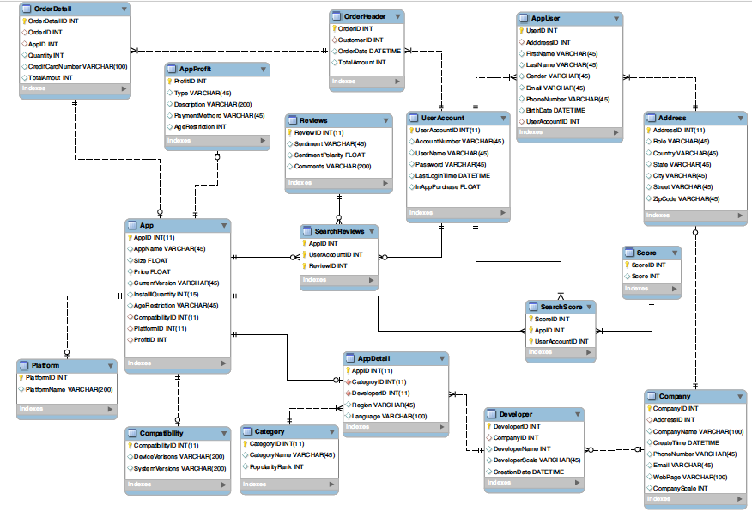
ERD

Slide 6
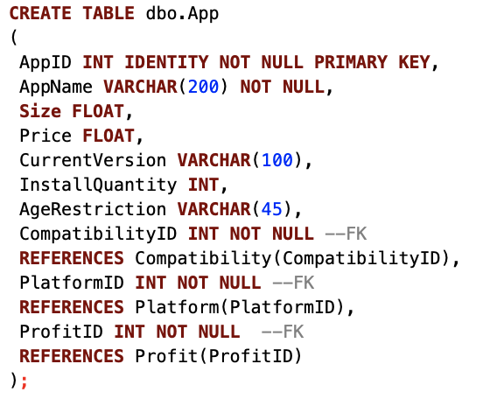
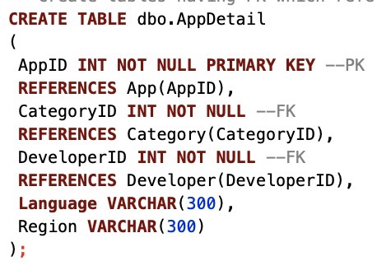
Create Table

Slide 7
Database Implementation
2
Visualization of Highlights

Slide 8
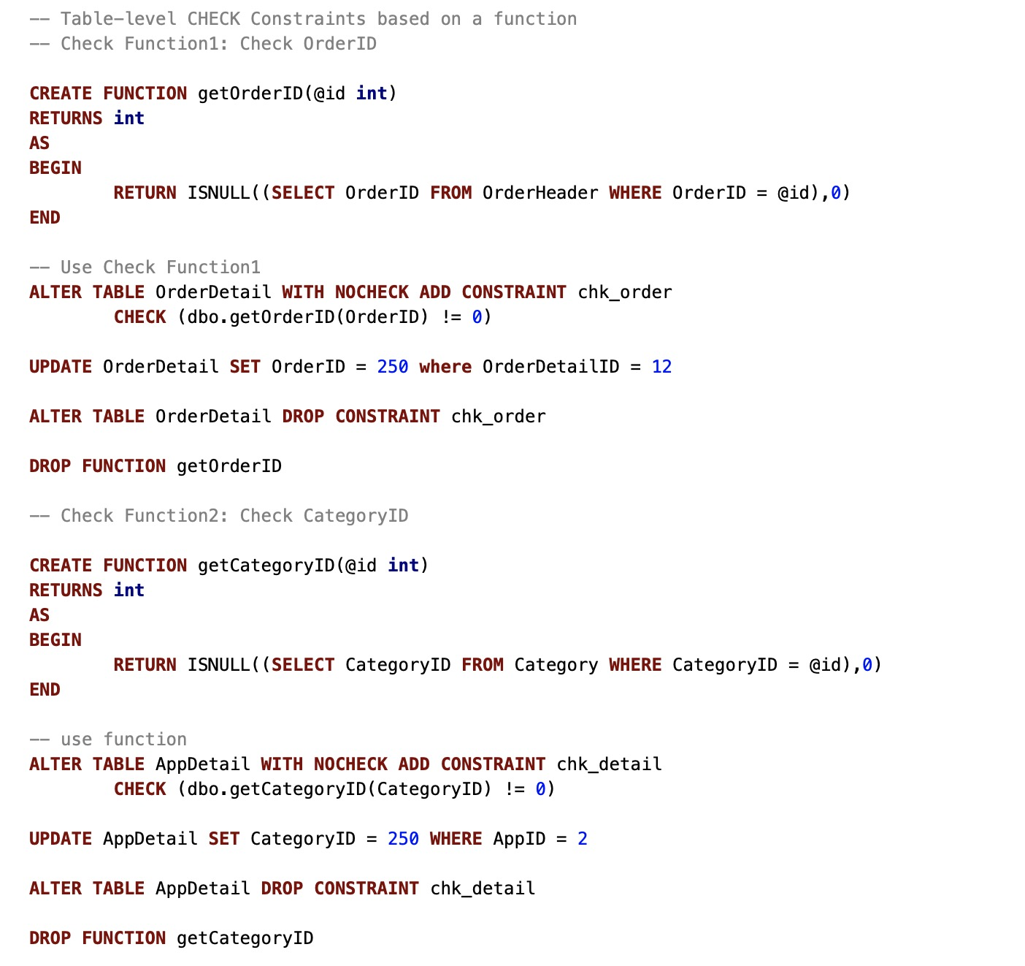
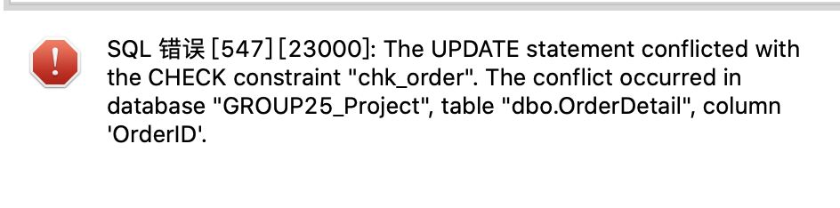
Table Level Constraints

Slide 9
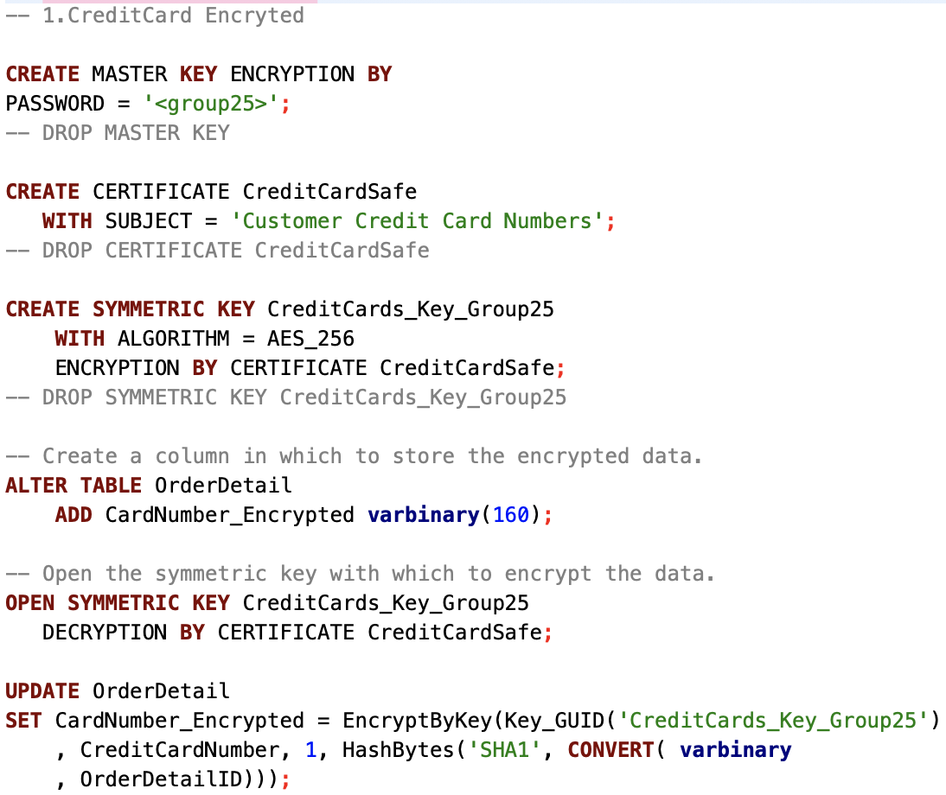
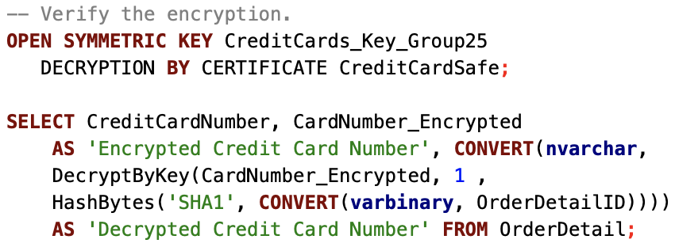
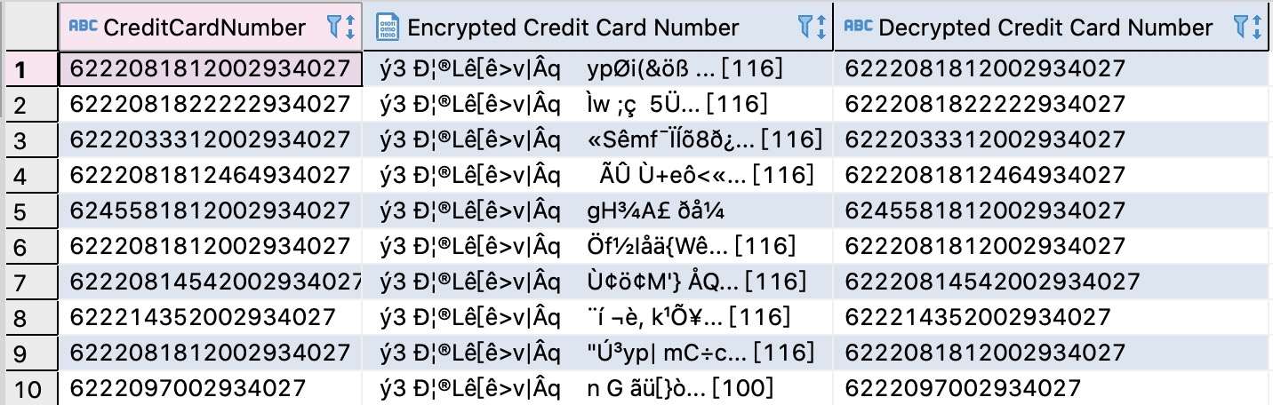
Column Data Encryption --- Number Encryption

Slide 10
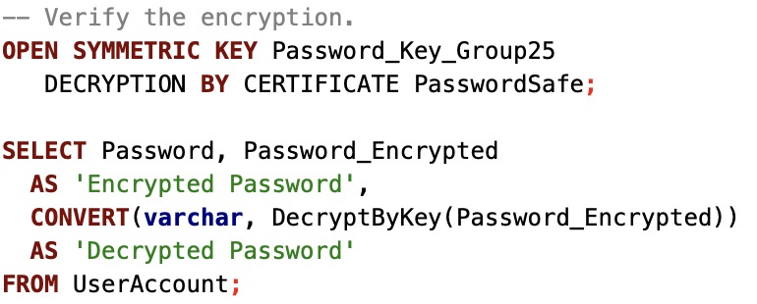
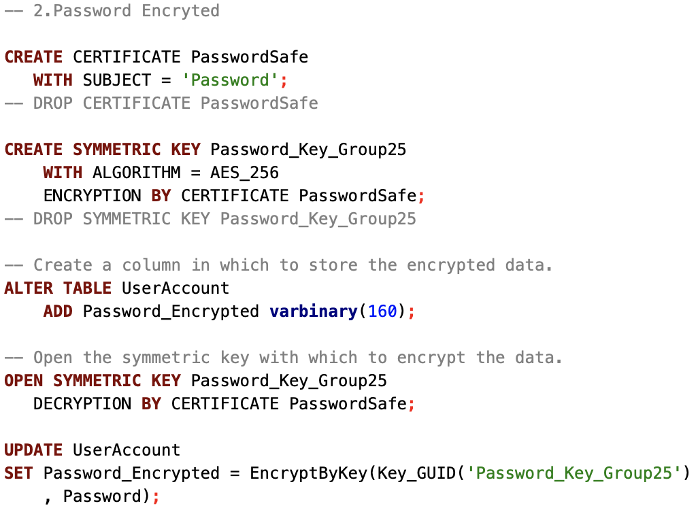
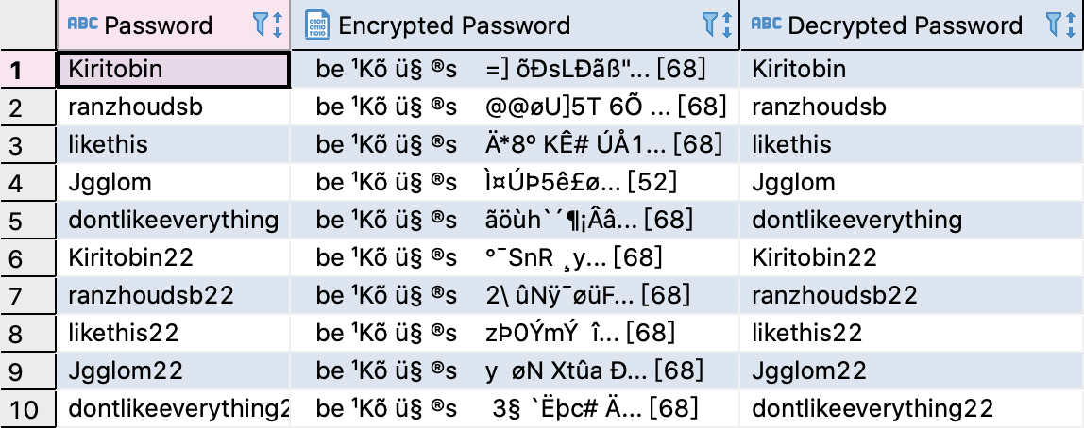
Column Data Encryption --- String Encryption

Slide 11
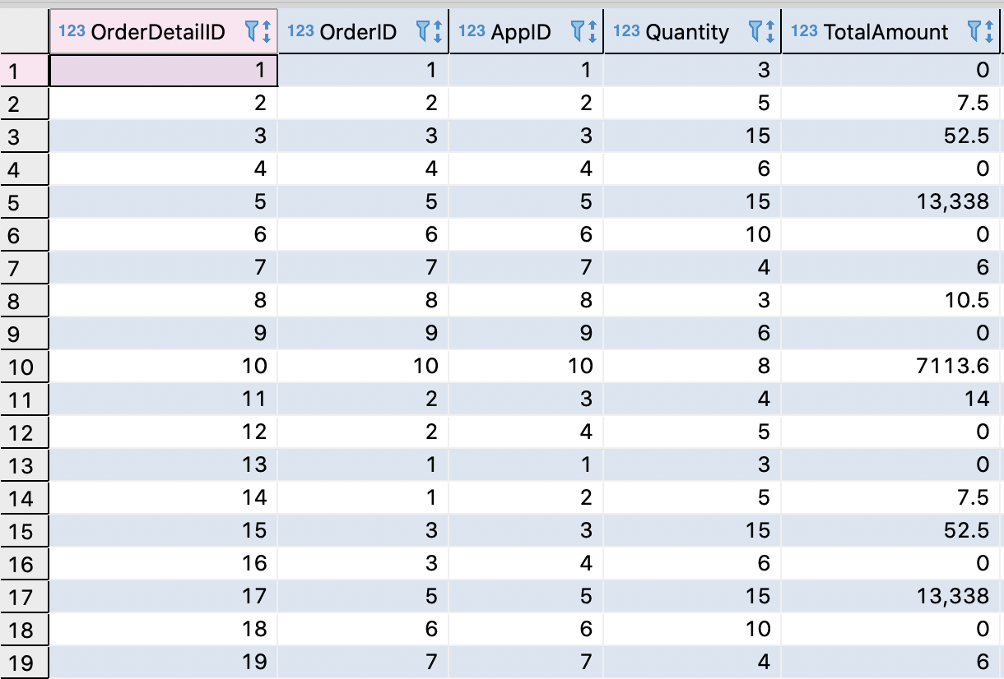
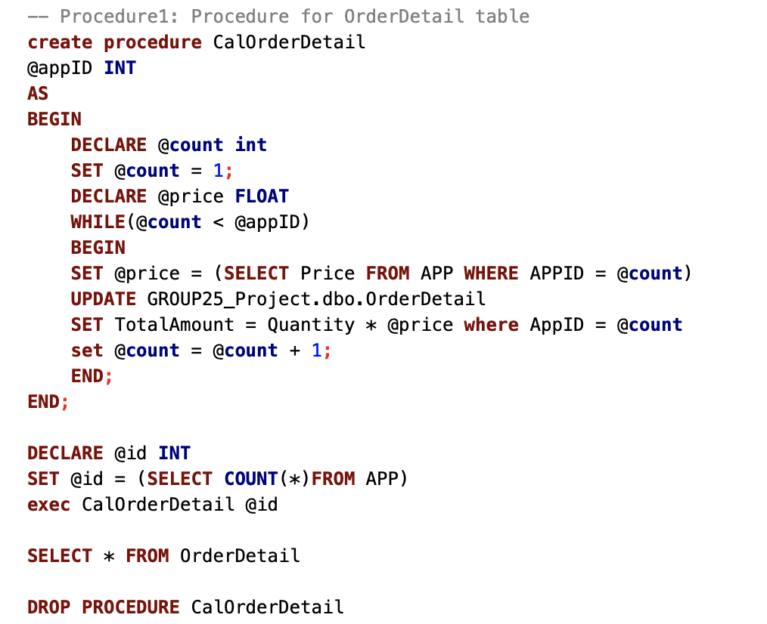
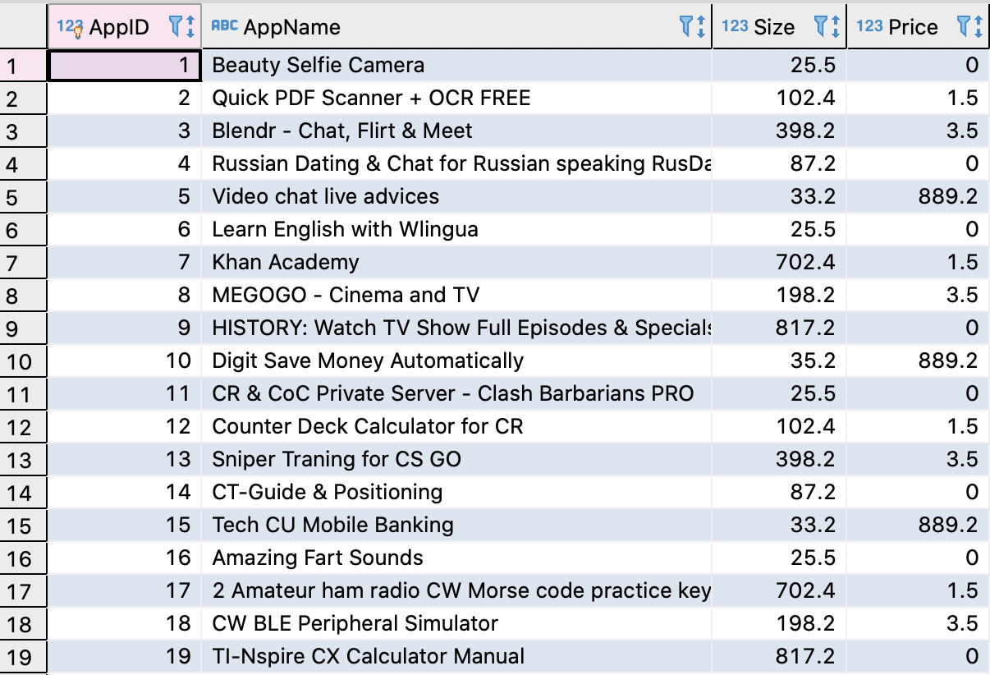
Calculate Column by Using Procedure

Slide 12
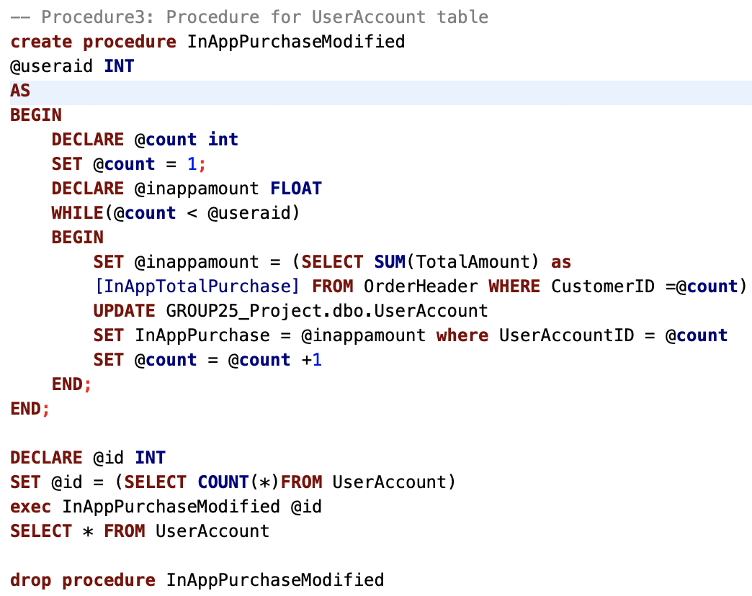
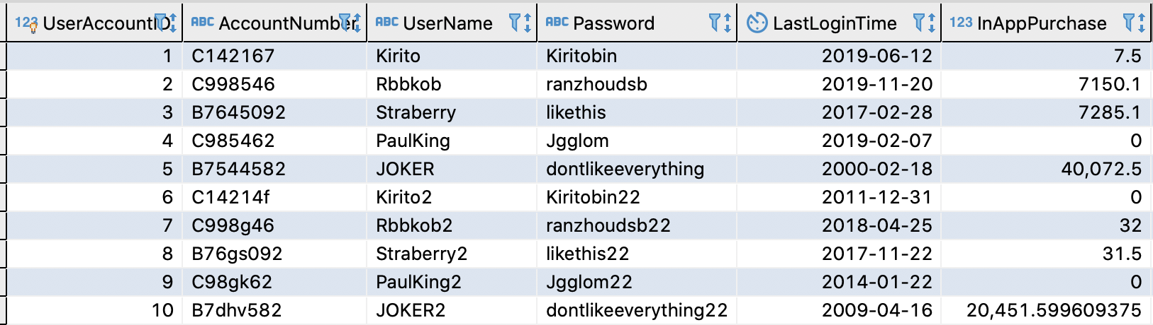
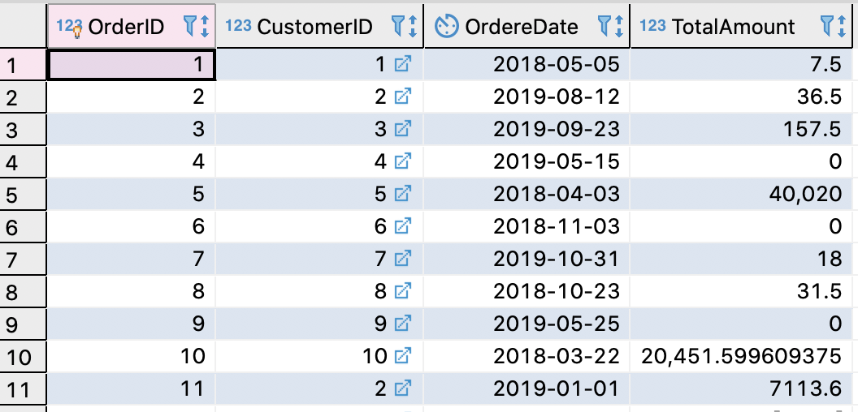
Calculate Column by Using Procedure

Slide 13
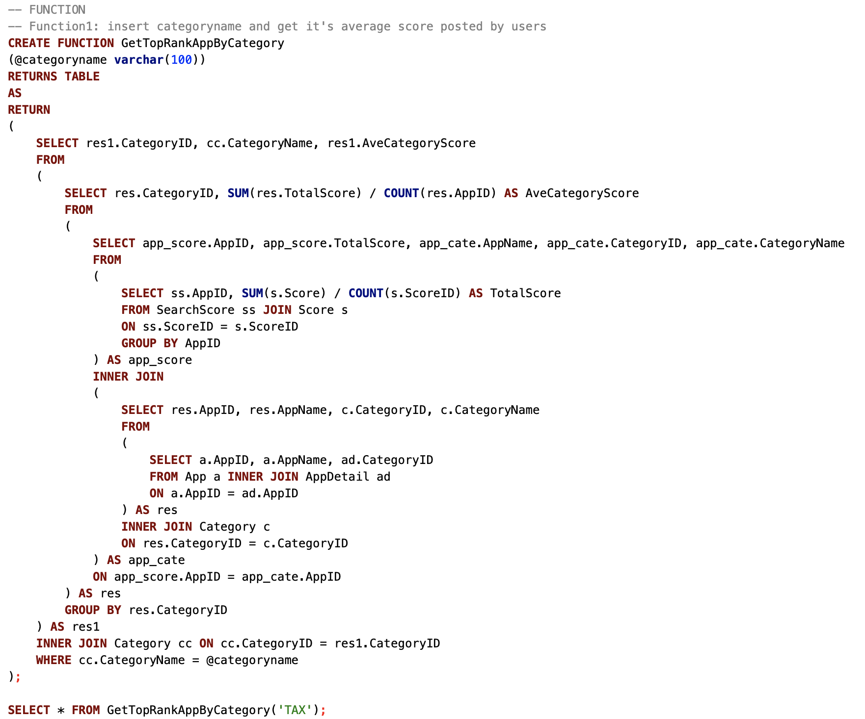
SQL FUNCTION

Slide 14
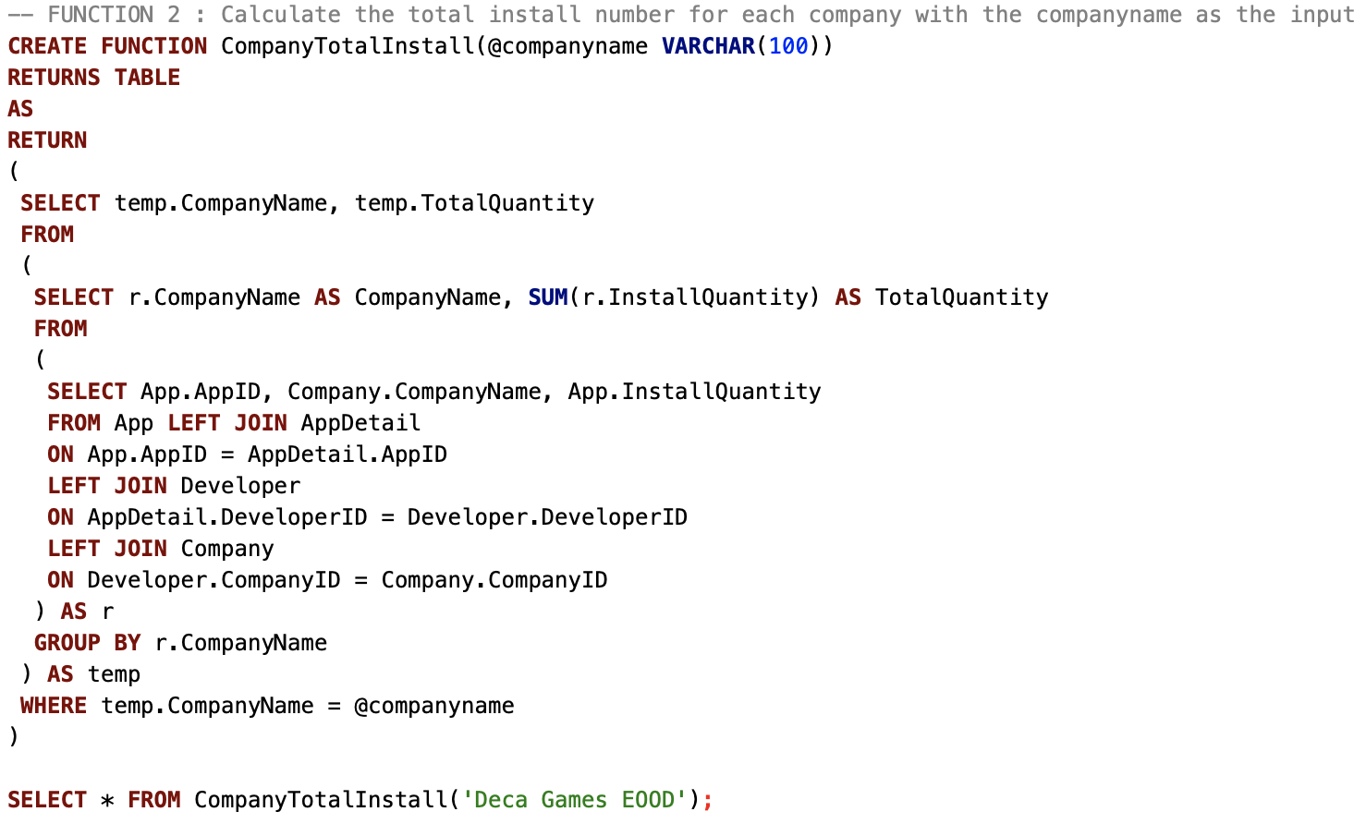
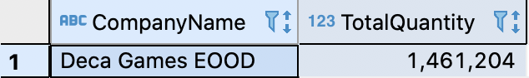
SQL FUNCTION

Slide 15
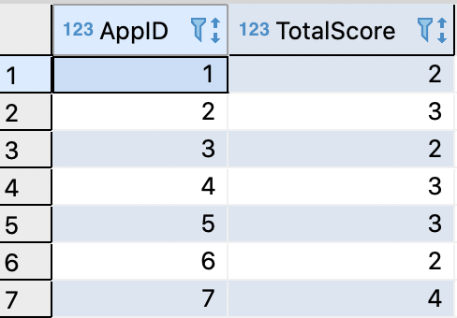
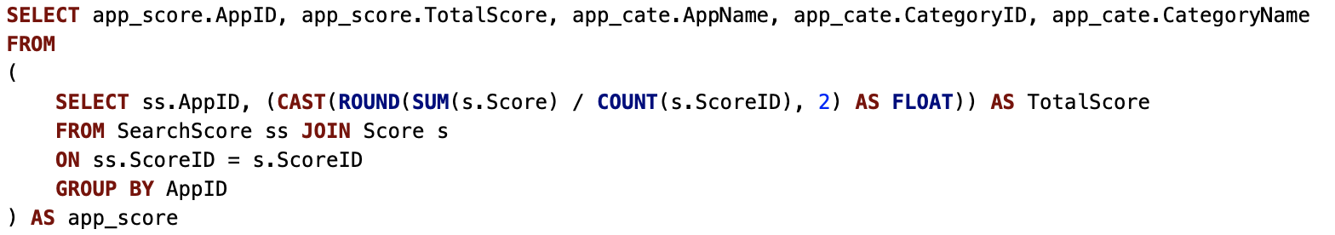
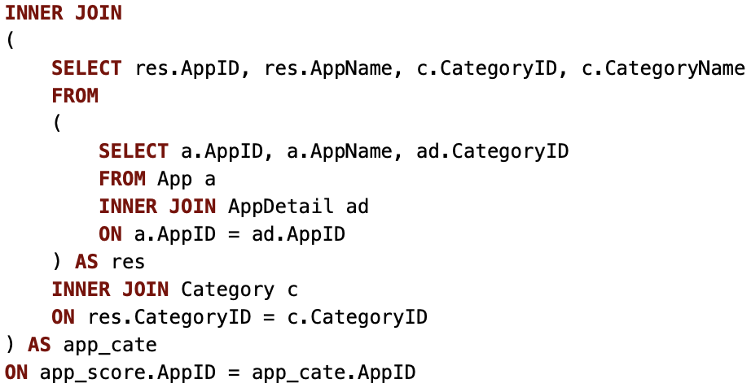
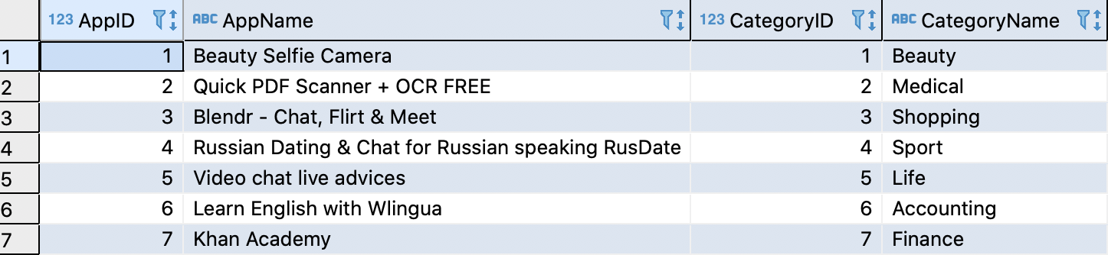
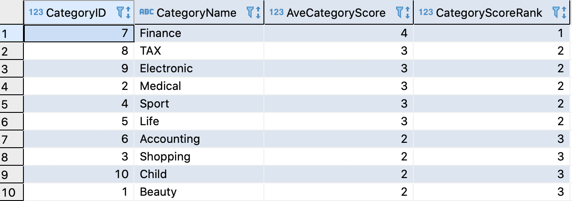
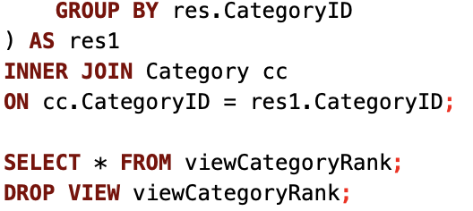
SQL VIEW

Slide 16
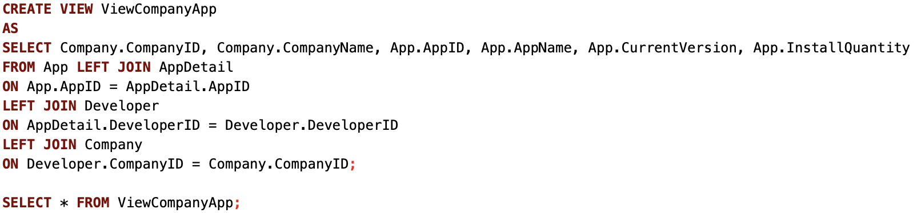
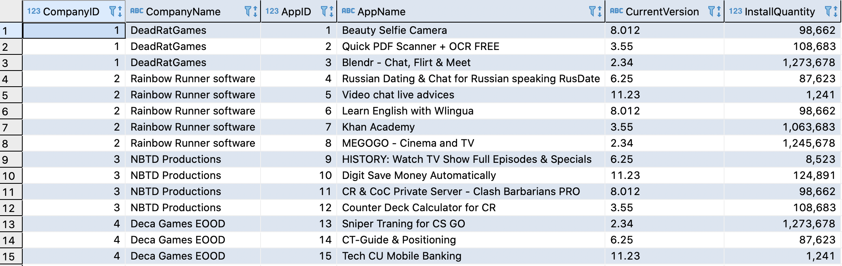
SQL VIEW

Slide 17
Reports
3
Generated by Tableau

Slide 18
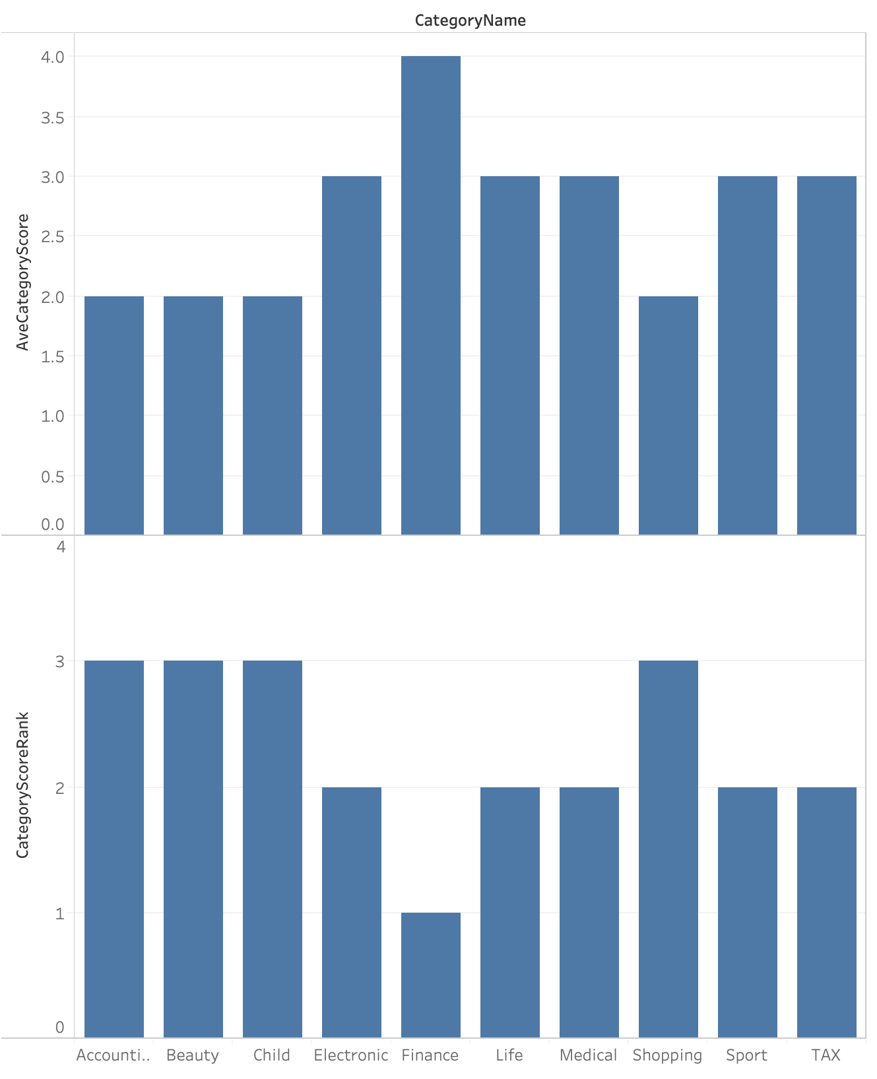
Category with Average Score & Rank

Slide 19
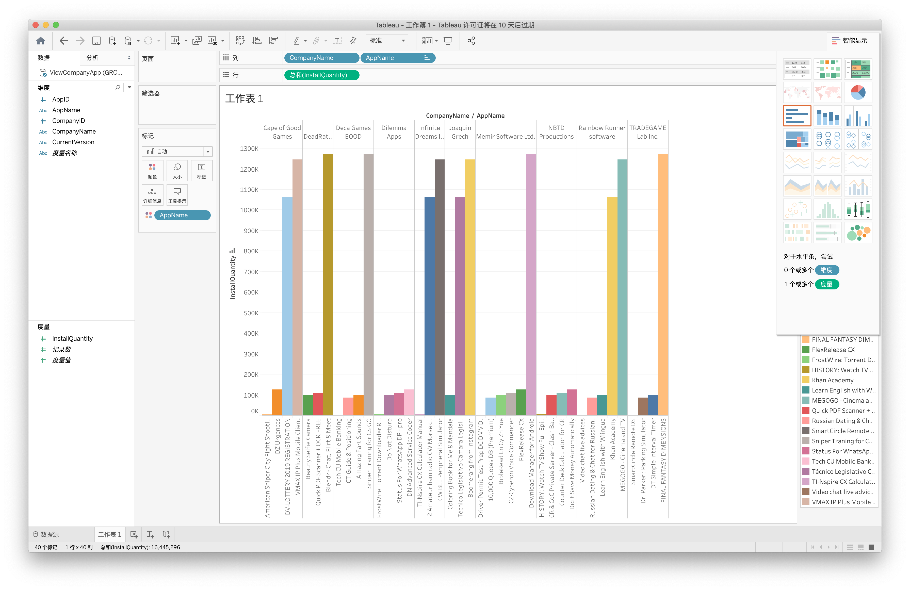
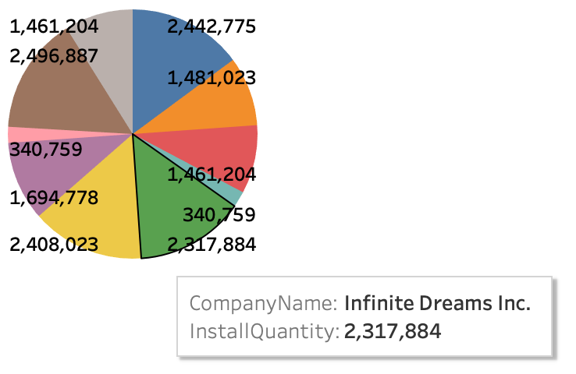
Company Developed App

Slide 20
THANKS!
Any questions?

